Slide 1
TAMHSC Clarion Case Competition informational session
Dr. kim Zemanek, assistant director
office of interprofessional education & research

Slide 2
Clarion informational session agenda
What is Clarion?
Why Clarion?
Pillars of Clarion
Competition Details
Local Clarion Case Competition
National Clarion Case Competition
How to Register for the Local Competition

Slide 3
What is clarion?
CLARION focuses on:
Professional development of health professional students
Includes lessons in:
leadership, teamwork, communication, analytical reasoning, conflict-resolution, and business practices.
Clarion - University of Minnesota
Notes:
CLARION focuses on the professional development of health professional students and includes lessons in leadership, teamwork, communication, analytical reasoning, conflict-resolution, and business practices. Participation in CLARION leads students to a more sophisticated understanding of the healthcare system in which they will practice.

Slide 4
Why clarion?
Safe and high-quality care for patients.
Medical Errors are the 3rd leading cause of death in the United States (Makary & Daniel, 2016)
Miscommunication and lack of communication
Breaking down the isolated disciplinary silos in which students are trained is required
Clarion – University of Minnesota
Notes:
The cause is safe and high-quality care for patients. Tens of thousands of deaths occur each year from preventable medical errors. Miscommunication and lack of communication among caregivers are cited as a main cause of the problem.
The call from leaders in the healthcare field, such as the Institute of Medicine and the Institute for Healthcare Improvement, is that the safe, high-quality patient-centered health care system patients deserve will require breaking down the isolated disciplinary silos in which students are trained.

Slide 5
Pillars of clarion
Leadership
Interprofessional Teamwork
Communication
Patient Safety and Quality
Patient-Centered Care
Clarion – University of Minnesota

Slide 6
Competition details team composition & rules
Four students per team
Must represent at least two different professions and no more than 2 of the same professions on each team:
Healthcare Administration (Part of our School of Public Health)
Medicine
Nursing
Pharmacy
Dentistry
Public Health
+ any other medically-related field
Notes:
~ no more than two students from the same profession.
Each institution participating is only allowed to send one team.

Slide 7
Competition details team composition & rules
Participants must be full-time students
Participants may only compete at the national competition once. National teams must be comprised of new participants annually. However, if you competed last year at the local competition but your team did not advance to the national competition then you can compete again this year.
Notes:
Participants must be full-time students at the institution they represent. Please note: Full-time students who are also employed in professional leadership positions are not eligible to compete. Exceptions will be reviewed by the CLARION Executive Board on an individual basis.
Participants may only compete once. Teams must be comprised of new participants annually.

Slide 8
Local clarion case competition
Registration is limited and granted on a first-come, first-serve basis.
The Local Case Competition is only open to Texas A&M Health Science Center students.
Participation is free! Register HERE until midnight, January 20, 2020.
*Team & Individual Registrations
Notes:
Winners of the local competition will be sponsored for the national competition by the TAMHSC’s Office of Interprofessional Education & Research.

Slide 9
Local case competition important dates
Information Session: Wednesday, November 13, 2019 Noon-1:00pm
Registration Opens: Wednesday, November 13, 2019
Registration Closes: Midnight, Monday, January 20, 2020
Mandatory Local Case Competition Orientation: Saturday, January 25, 2020 10AM-Noon (Teams announced)
Case and Guidebook Released: Saturday, January 25, 2020 at Orientation
Local Case Competition Date: Saturday, February 29, 2020

Slide 10
Local case competition participant information
Case Competition Guidebook includes:
Rules and regulations
Roles for students and advisors
Team definitions
Judging criteria
Contact information for additional questions
Technical assistance for team development
Notes:
Registered teams will receive a Case Competition Guidebook, which includes

Slide 11
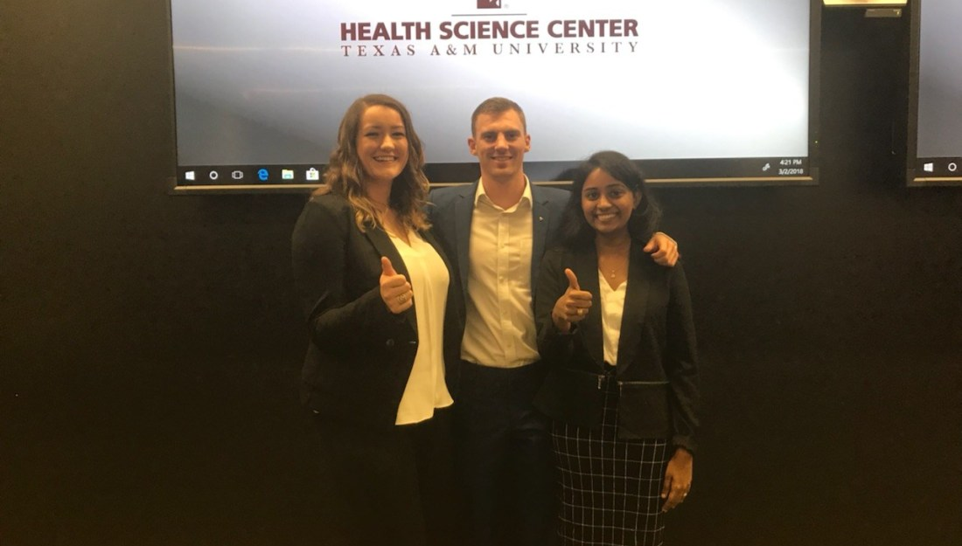
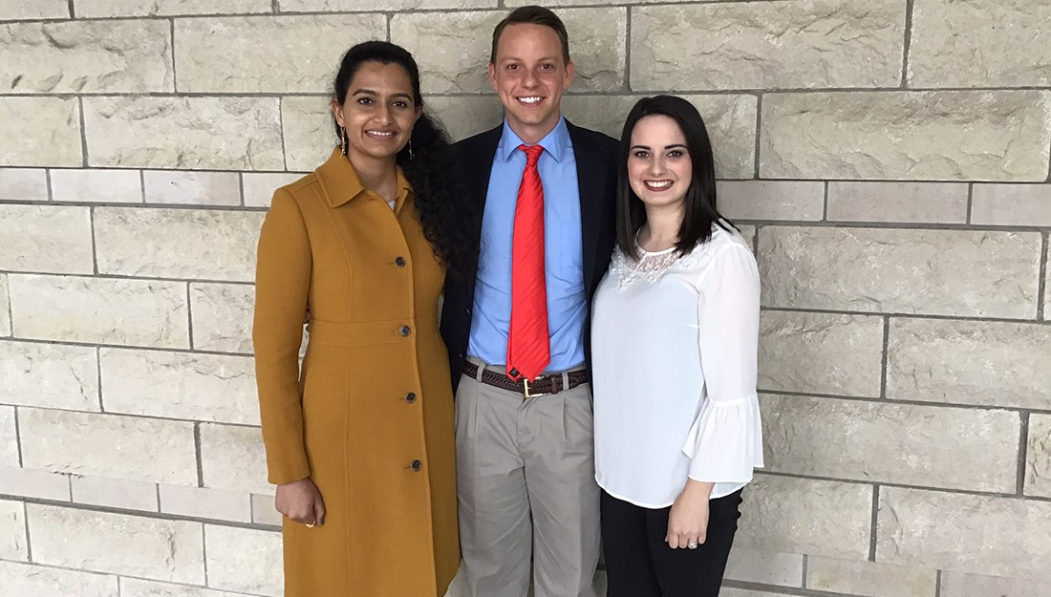
Mandatory local case competition orientation Saturday, January 25, 2020 10AM-Noon Bryan Campus in Hpeb LL43 A
Team assignments announced
Teams receive Case and Guidebook
Overview of competition rules
Hear from former participants

Slide 12
National clarion case competition University of Minnesota
Tentative Schedule
Friday, April 17th, 2020
Optional Presentation Practice Sessions (10am - 3pm)
Location: Coffman Memorial Union
Interprofessional Escape Room (3pm - 5pm)
Location: Bentson Healthy Communities Innovation Center
National Case Competition Welcome Reception Dinner (5pm - 9pm)
Location: Weisman Art Museum
Saturday, April 18th, 2020
Presentations (8am - 5pm)
Location: Coffman Memorial Union
Teams will be assigned a presentation time and room prior to the competition day.
National Competition Awards Banquet (5:30pm - 9pm)
Location: Coffman Memorial Union: Campus Club
Notes:
This is for the winning Clarion local team. I wanted to show you these dates so you can be thinking ahead to “if I win, would I be able to represent my team at the national competition”.

Slide 13
Frequently asked questions
Can teams have alternate students?
For the TAMHSC Local Competition, how are teams formed?
Who are the judges the students will be presenting to?
Who determines/forms the case for the competition?
What student level usually participates in this competition?
How long do teams get to work on the case? Is the same case used for the local and national competition?
Notes:
Can teams have alternate students? No. The maximum number of students who can participate (research, planning, presenting, etc) on the team is four.
For the TAMHSC Local Competition, how are teams formed? Students register individually and are randomly assigned to a team or register a team (must follow team composition rules).
Who are the judges the students will be presenting to? The panel of judges will consist of an interprofessional team of experts and practitioners in the healthcare field. Teams usually present to four to five judges.
Who determines/forms the case for the competition? The topic of the case is determined based on current systemic issues in healthcare. A team of healthcare faculty at the University of Minnesota lead the case writing, and consult with subject matter experts on the year’s topic.
What student level usually participates in this competition? The case competition is open to all health professional students, including both bachelor level (e.g. Bachelor of Science in Nursing students) and master/doctoral level (e.g. Master of Public Health, Medicine, Pharmacy, etc). For undergraduate programs, participation in the Junior or Senior year is recommended.
How long do teams get to work on the case? The case is released to all participants at the same time, in late January. Many schools (including the University of MN) host local competitions in early-mid March, giving teams about six weeks to prepare. The National Competition takes place in mid-late April, so teams competing in the national competition have about 10-12 weeks from the time the case is released to the time of the competition.
Is the same case used for the local and national competition? Yes.

Slide 14
Questions?
Please contact Dr. Kim Zemanek at kzemanek@tamu.edu or 979.436.9115 with any questions.

