Slide 1
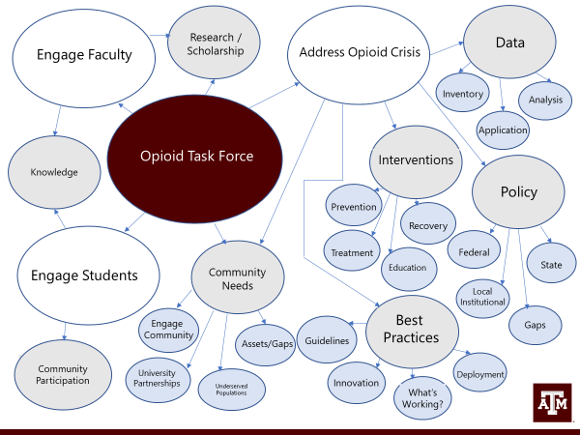
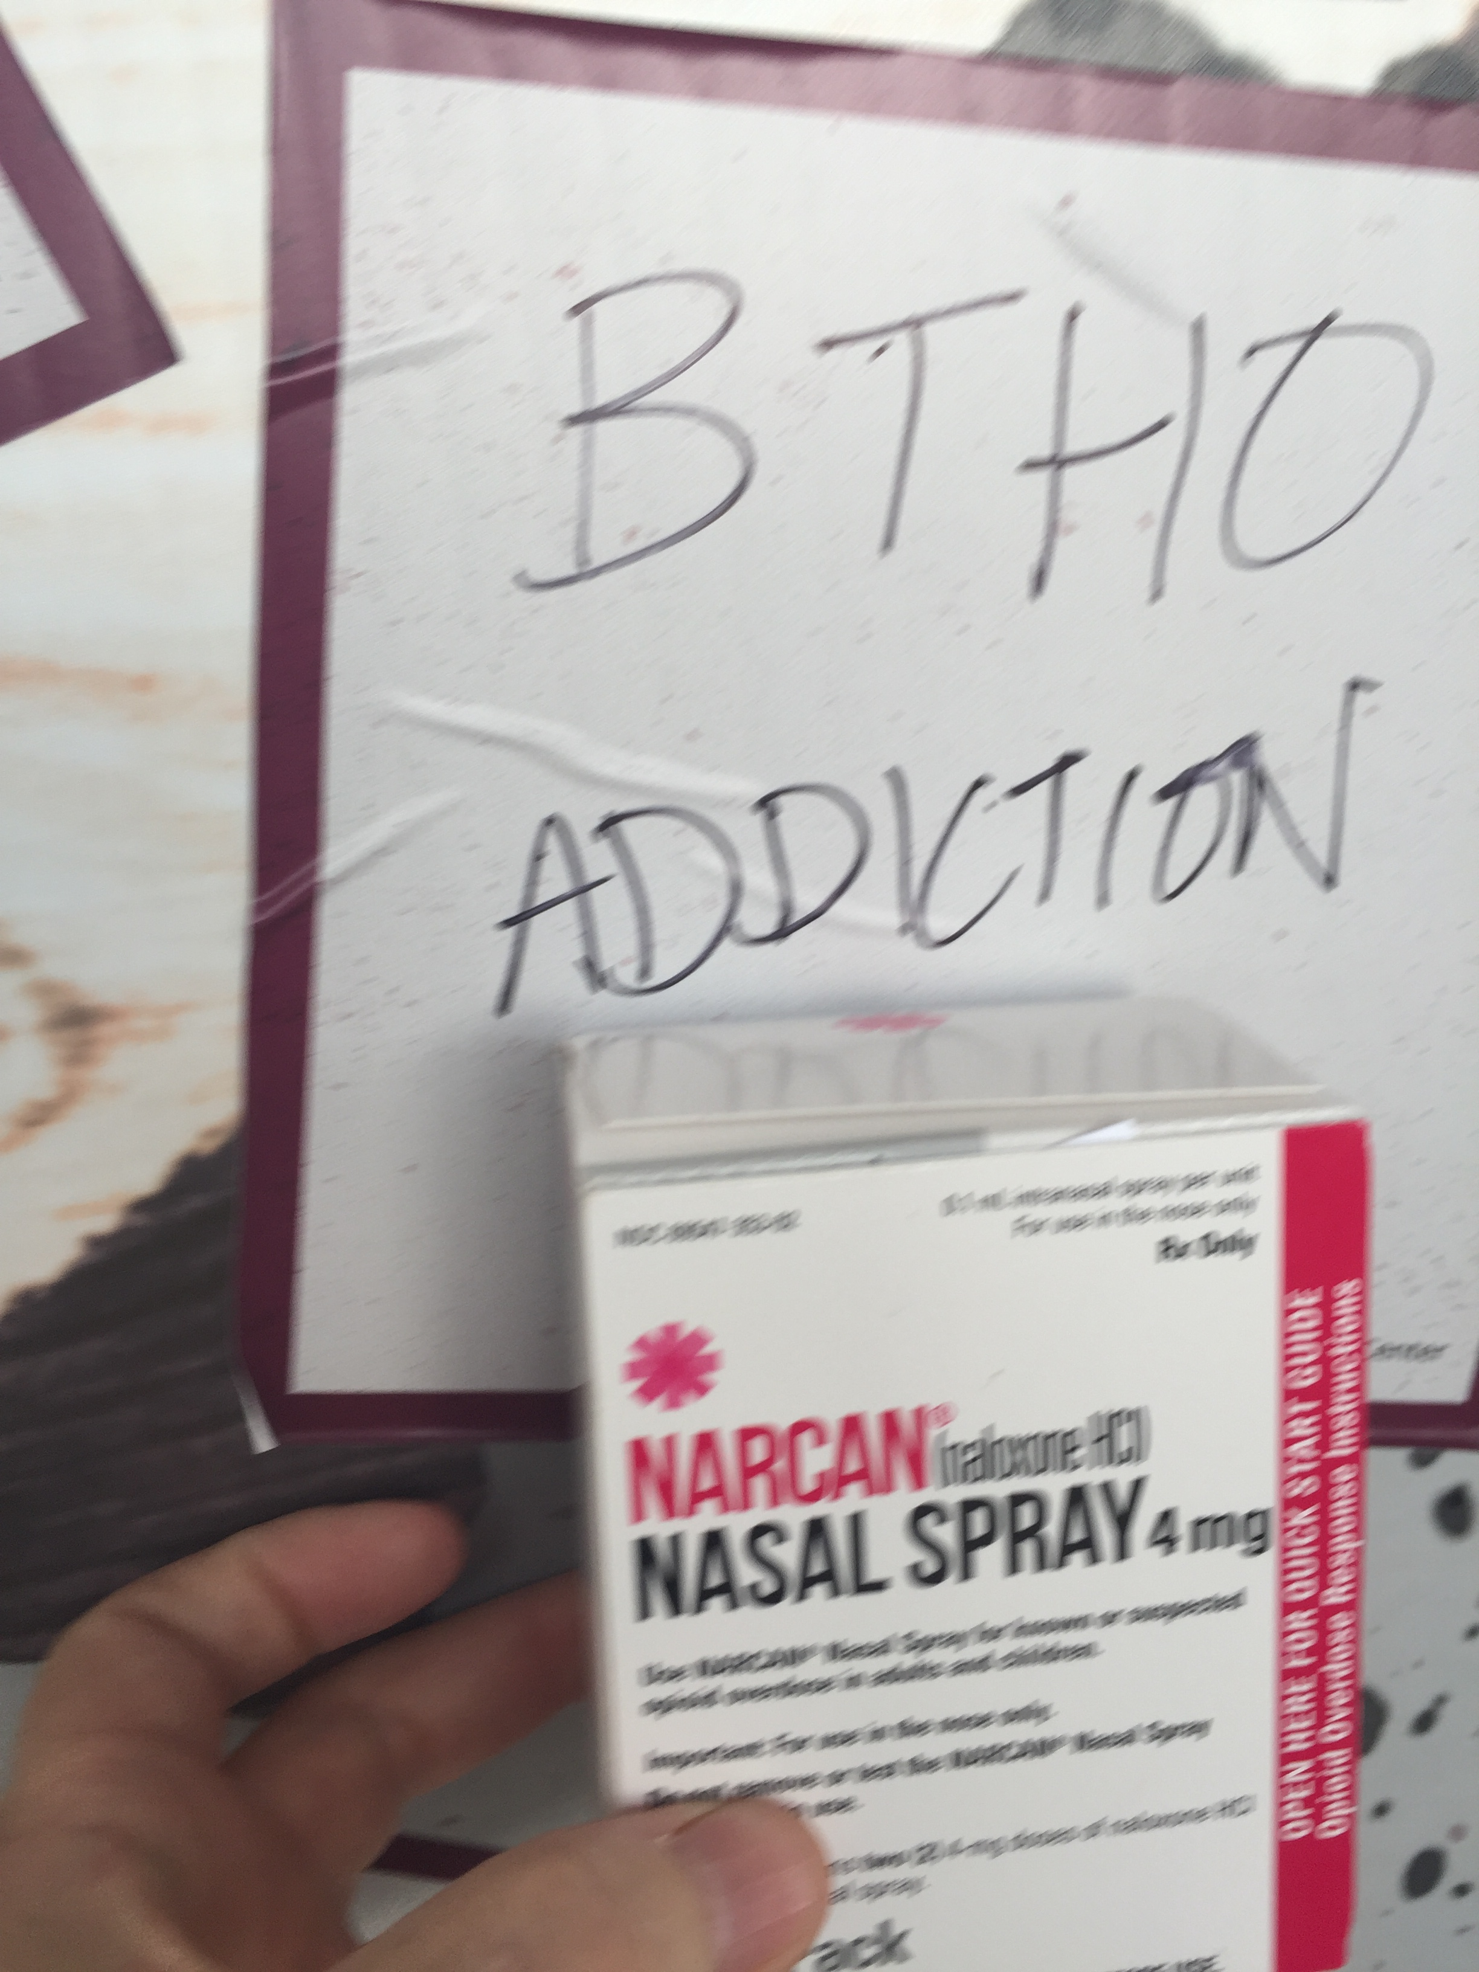
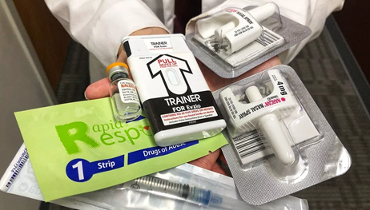
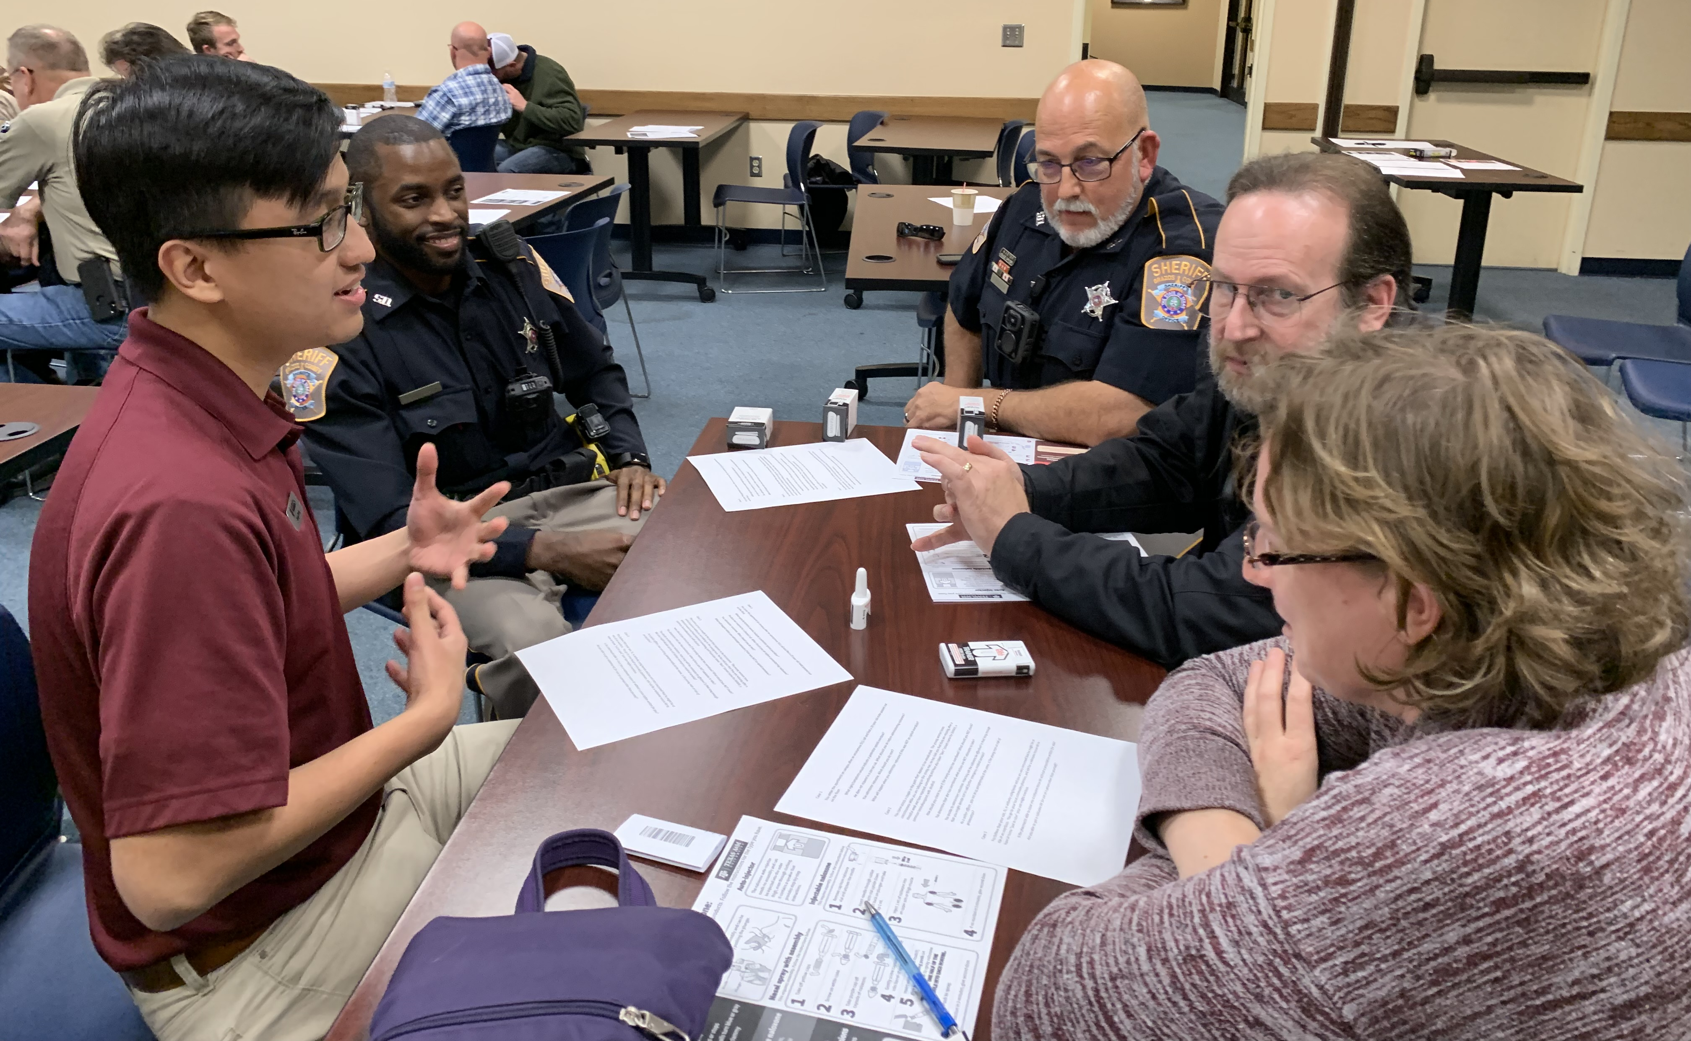
 |  | Un
“Interprofessional Student Integration into the Texas A&M Opioid Overdose Education & Naloxone Administration (OENA) Training Public Health Initiative”
Joy P. Alonzo¹, Marcia Ory^{2,} Shinduk Lee^{2,} Carly McCord³, Michael Ellis⁴, Cheryl Pullium⁵, Chinelo Nsobundu²
¹Texas A&M Rangel College of Pharmacy
²Texas A&M Irma School of Public Health
³Texas A&M College of Medicine
⁴Texas A&M College of Dentistry
⁵Texas A&M College of Nursing
OTF Student Ambassador
Key Accomplishments
10 documented Opioid Overdose Reversals/lives saved
447 OTF Student Ambassadors trained
More than 7500 Community Service Clinical hours accrued
18 Student-Led IPE Research Projects presented at national conferences with IPE teams
Naloxone rescue kits distributed to more than 6000 community members to include community coalitions, justice department, community college students/faculty, civic associations, school nurses, & MHBH treatment centers.
4000 Law Enforcement Assets trained
Largest Mass Naloxone Training Event in the US held during Disaster Week!
*Knowledge-based questions on Pre-Test & Post-Test are designed to assess general knowledge of opioid characteristics & pharmacology, opioid overdose signs and symptoms, naloxone pharmacology and naloxone administration, and Texas law regarding naloxone.
**Attitude questions on Pre-Test & Post-Test are designed to assess
Attitudes regarding harm reduction principles such as the use of
Naloxone to reverse and overdose, syringe exchange programs,
Safe-use programs, and medication-assisted treatment.
BACKGROUND
Texas A&M Opioid Task Force (OTF) formed in response to declaration of the US Opioid Epidemic as a National Public health Crisis.
Established as an Interprofessional consortium with representatives from all 5 Texas A&M Health components.
Goal of OTF: reduce the burden from the current opioid epidemic through collaborative action across the health sciences and diminish escalating negative impacts.
Address the 5 strategies articulated by the US Health and Human Services Administration which INCLUDES wider access and distribution of Naloxone Rescue Kits in order to decrease fatal opioid overdose rates.
Received support in the form of 1.8 million dollars of naloxone from the Texas Targeted Opioid Response Grant. Developed education program in conjunction UT HSC components to provide training to accompany naloxone rescue kits.
The Student Opioid Task Force Ambassador program established to engage HSC students directly in interventions associated with the US Opioid Epidemic.
Student OTF Ambassador work force provides OTF the capability to conduct three times as many naloxone rescue trainings. Students complete training program to lead naloxone rescue presentations with minimal faculty oversight.
Per IRB protocol students are pre-tested and post-tested on their knowledge, attitudes, and self-efficacy regarding the Opioid Epidemic and naloxone rescue procedure.
***Self-efficacy questions on Pre-Test & Post-Test are designed to
Assess the respondent’s confidence in performing the Texas A&M
Opioid Overdose Action Plan to enact an opioid overdose reversal in the field.
80% increase
75% increase
*A series of questions were administered to determine the desire to continue to work
Both as a student and professionally in a collaborative, inter-disciplinary environment
** Questions administered were specifically designed to evaluate the understanding
Of the various health science professions of other roles on the health care team. This
Series of questions included policy and public health understanding.

